Slide 1
The Arkan Project
Pitch Slideshow
Henry Baldwin

Slide 2
Overview
The Arkan Project will be a game centered around exploring and base defense from monsters and zombies
Core gameplay includes combat, base defense, and material collection
An engaging story with in-depth lore will keep players invested

Slide 3
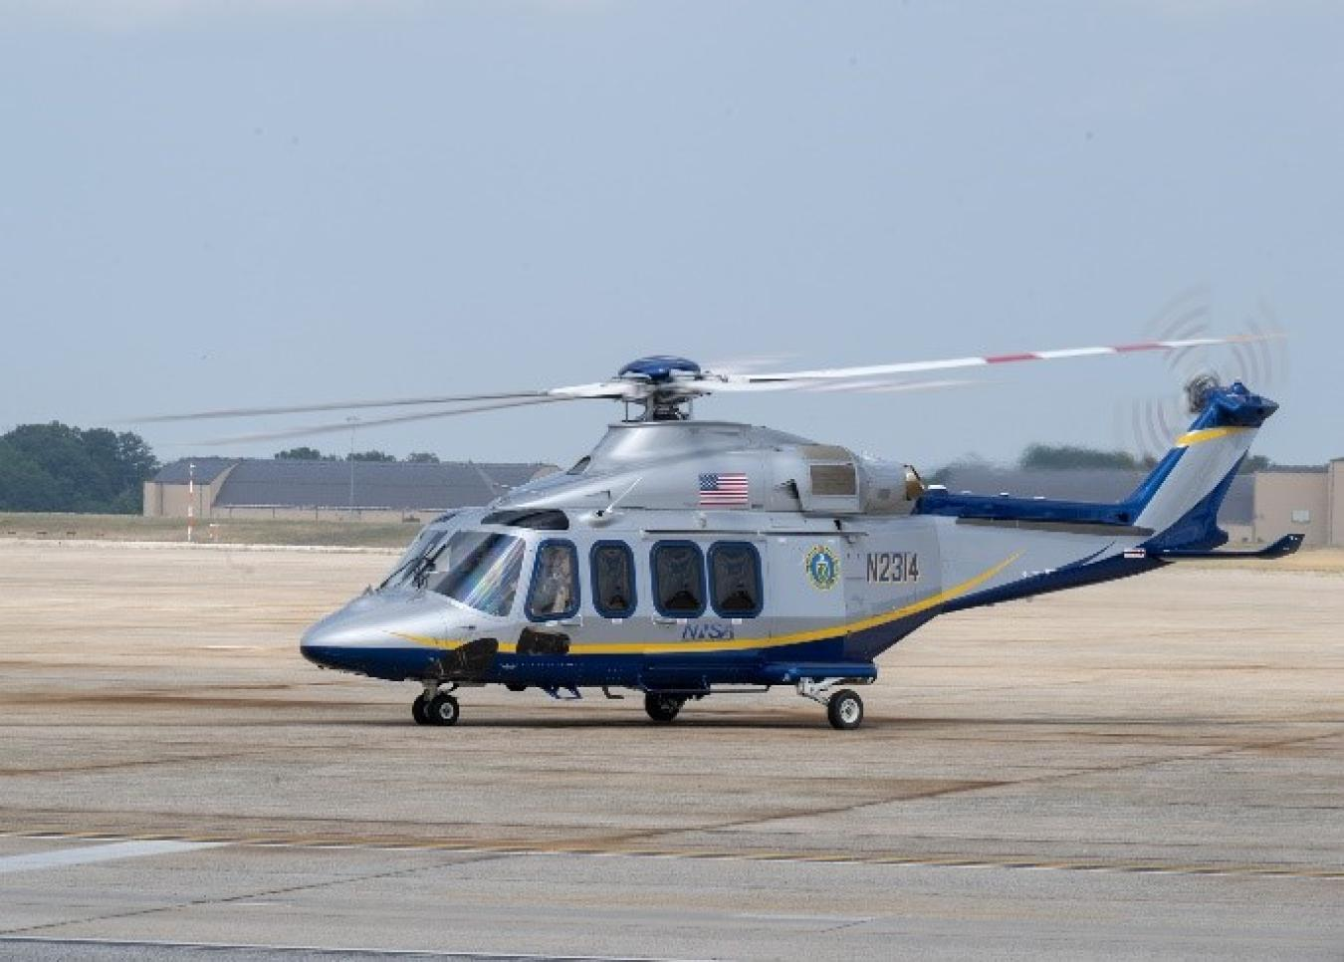
Storyline and Gameplay Loop
Soldier crashed a helicopter in a mysterious laboratory
Fight off monsters and uncover secrets
Build and defend base
Explore the area

Slide 4
Innovating With Camera Controls and Visuals
The Arkan Project will use a unique combination of isometric and first-person camera controls
With an isometric view similar to that of Hades for the resource collection/exploration half of the game, but a first-person perspective for the base protection half of the game
The Arkan Project will have a unique apocalyptic-feeling visual style with similar aesthetics as Call of Duty: Zombies, with a hint of the Hades visuals, although less colorful

Slide 5
Development Management and Goals
Our team is managed under a well-organize Trello board
We are making the game off of a 0 dollar budget, meaning we won’t have to pay for any licenses or tools beyond what is provided for us by Skyline High school
Iterative development methodology
We will be using Unity, Blender, Github, Audacity/Bandlab, and Photoshop for creating our assets
Each of our team members are very passionate about this project

Slide 6
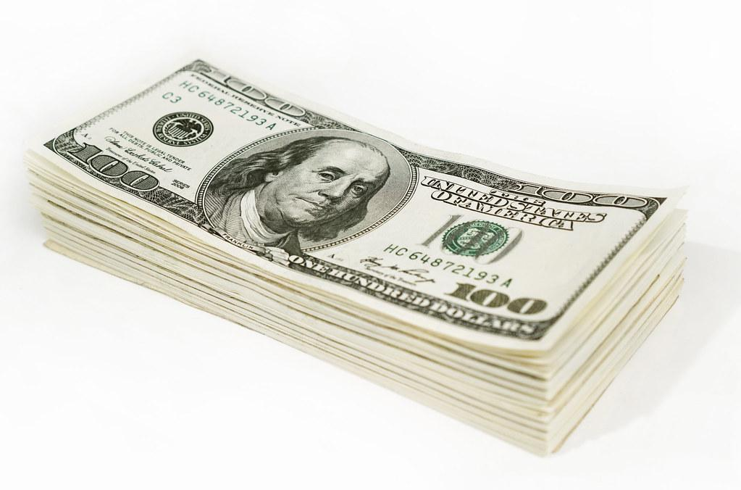
Tools, Finances, and Budgeting
Our game will have a budget of zero dollars!
We will only be using free tools and the tools that Skyline High school provides
These tools include Github, BandLab, Photoshop, Tinkercad, Trello, and Unity

Slide 7
Distribution
We currently plan to distribute our game on a free online distribution channel like itch.io
This will help reach our target audience of teenagers and young adults, along with being inexpensive and accessible
We will advertise our game on social media platforms such as TikTok, Instagram, and YouTube

Slide 8
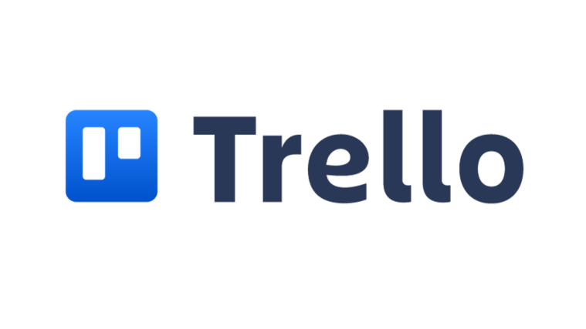
Development Milestones
All of our milestones are being tracked on Trello
Milestones include finishing sound design, finishing the plot, and finishing the pitch document and slideshow
Our Trello board is kept up to date

Slide 9
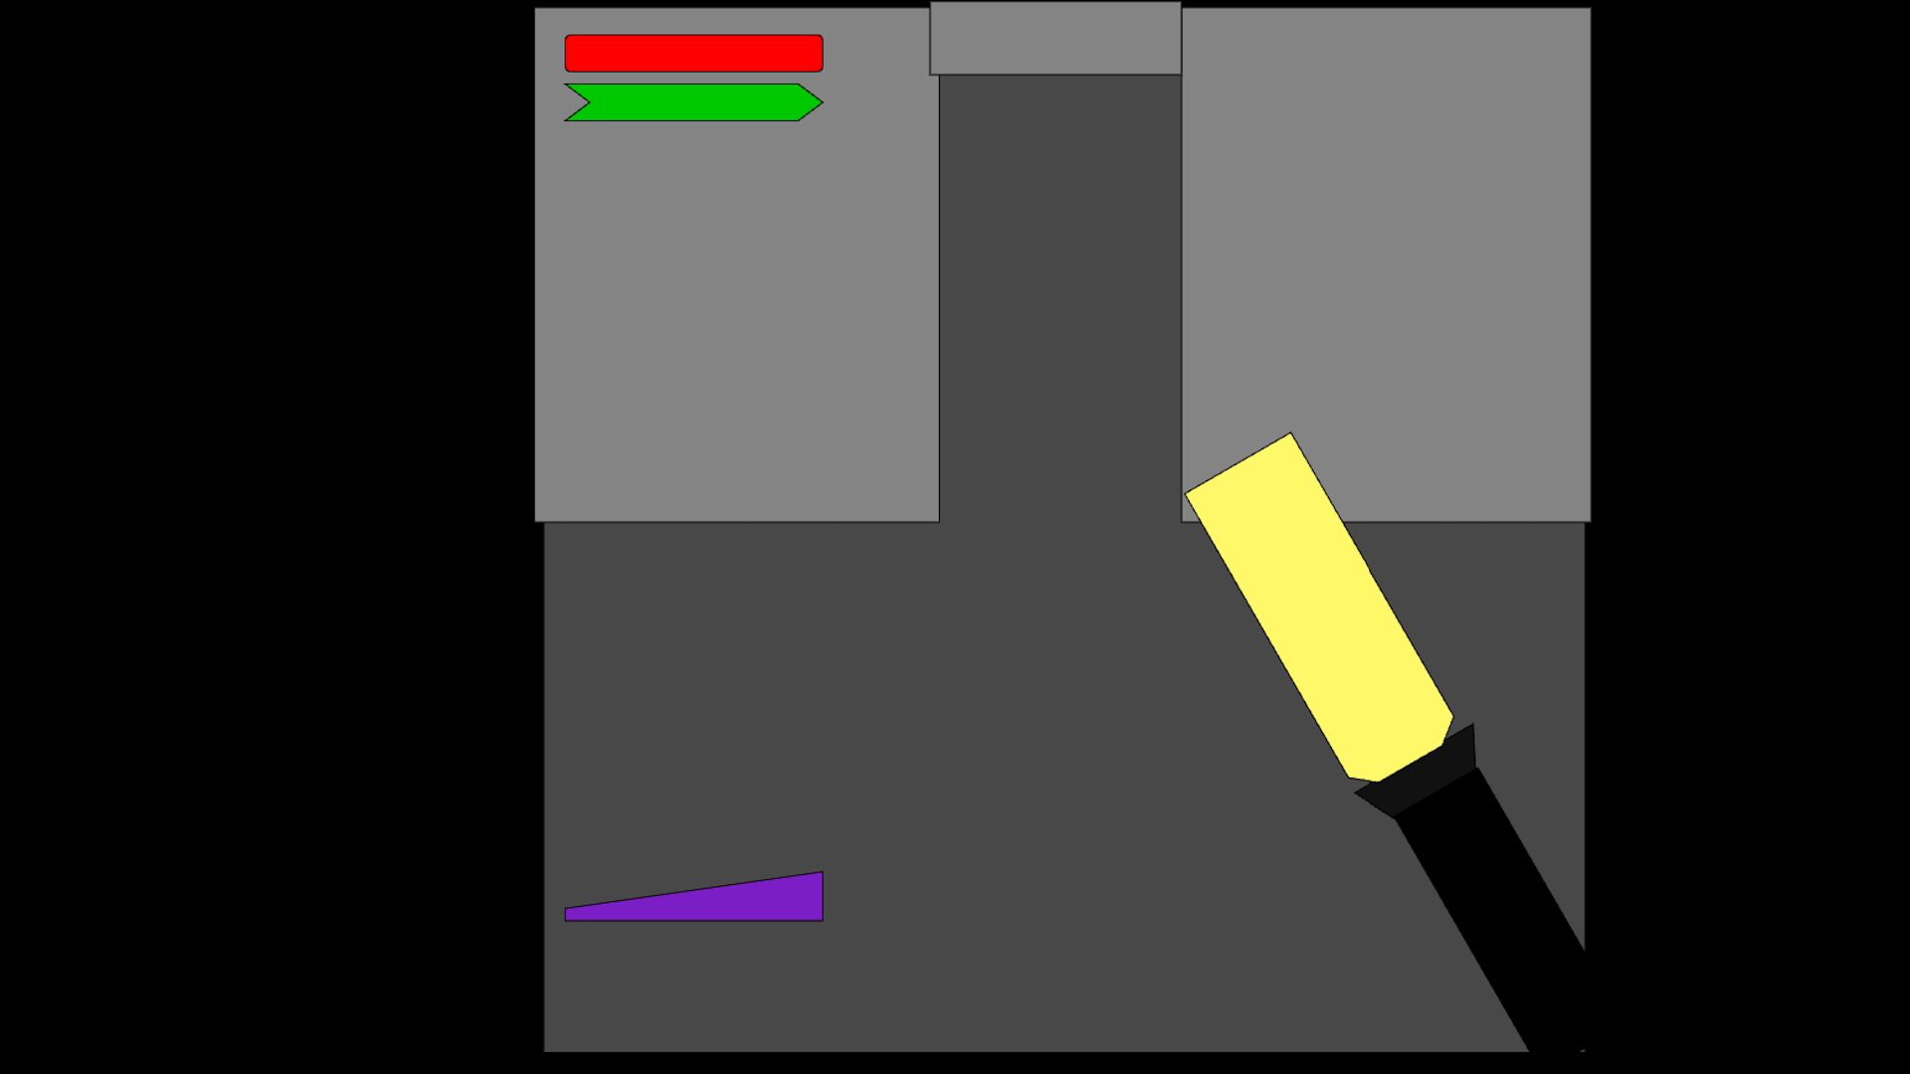
Visual Mockups (1/2)

Slide 10
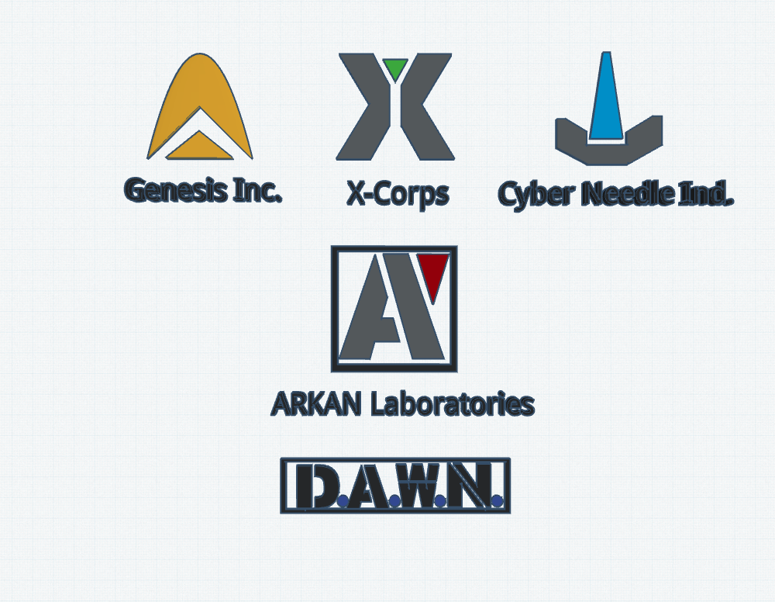
Visual Mockups (2/2)

